Slide 1


Slide 2
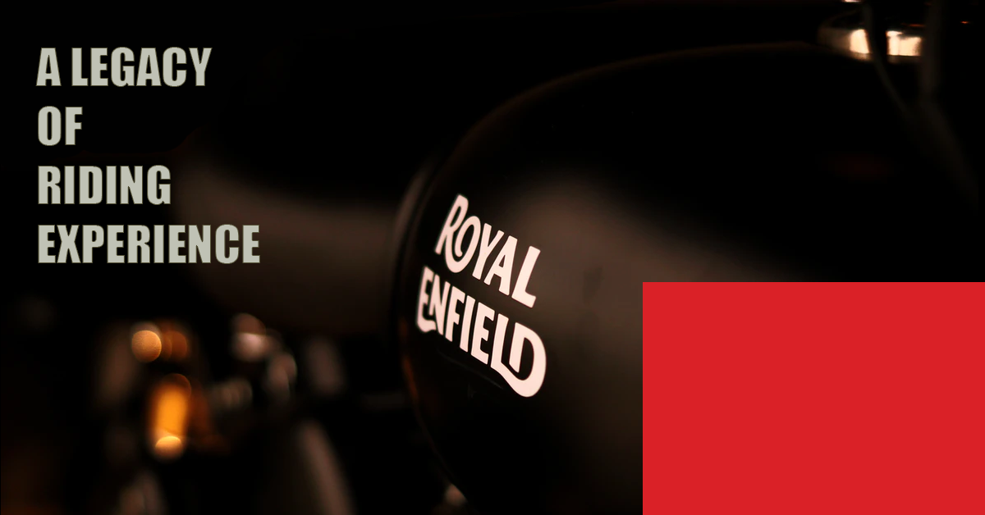

Sreeraj
Navthej
Janeesha
Meenakshy
Sreeraj
Rizal
Huda Jasmine
Group 10
Members
ADITYA B PRASAD
AISWARYA JOSEPH
AKHIL DINESH
AKSHAY A S
ARATHY A J
HUDA JASMIN
JANEESHA V S
JISHNU P NAIR
M.MEENAKSHY
NAVTEJ
RIZAL
R SREERAJ

Slide 3
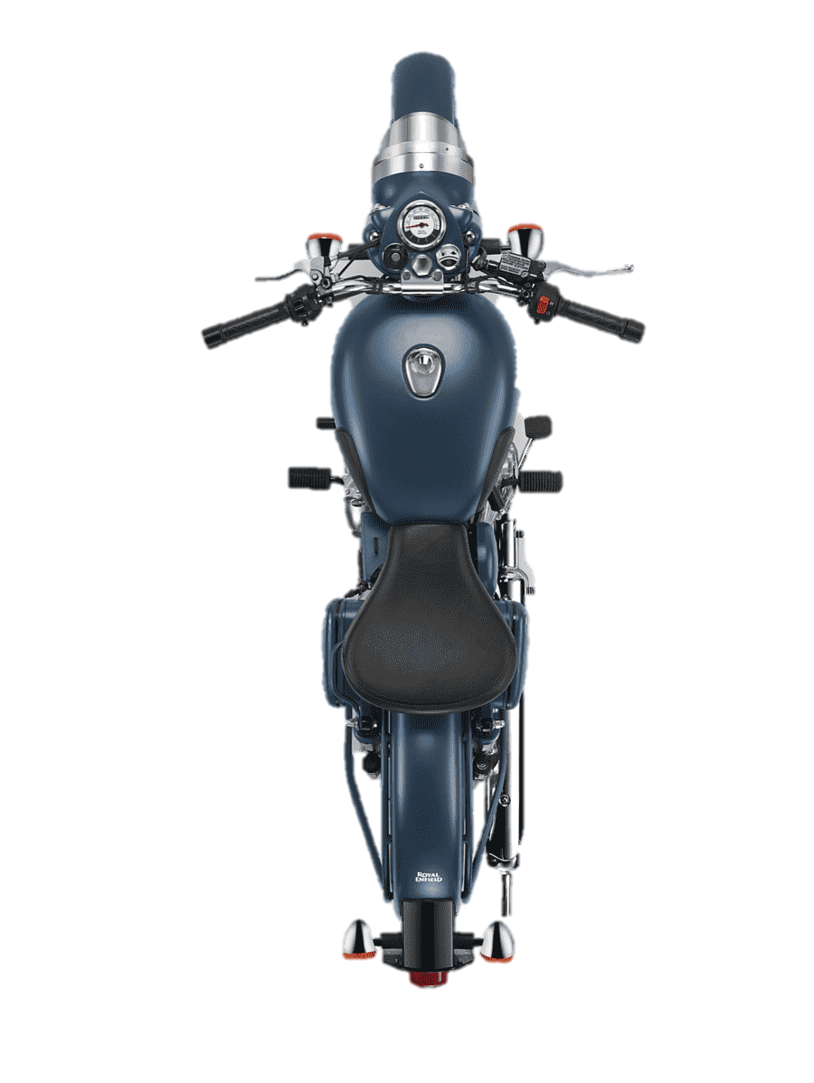
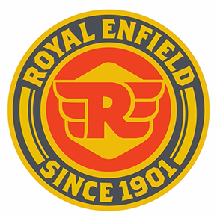
FOUNDED WHEN & BY WHOM ? INITIAL PRODUCTS
Royal Enfield is a well-known motorcycle manufacturer, primarily based in India.
• Founded in 1893 in Redditch , England
• Royal Enfield was founded by George Townsend and R.W. Smith
• Produced first motorcycle in 1901 which was powered by 1.5- horsepower engine
• Royal Enfield first V-twin, using a 297cc Swiss made Motosacoche engine in 1909

Slide 4
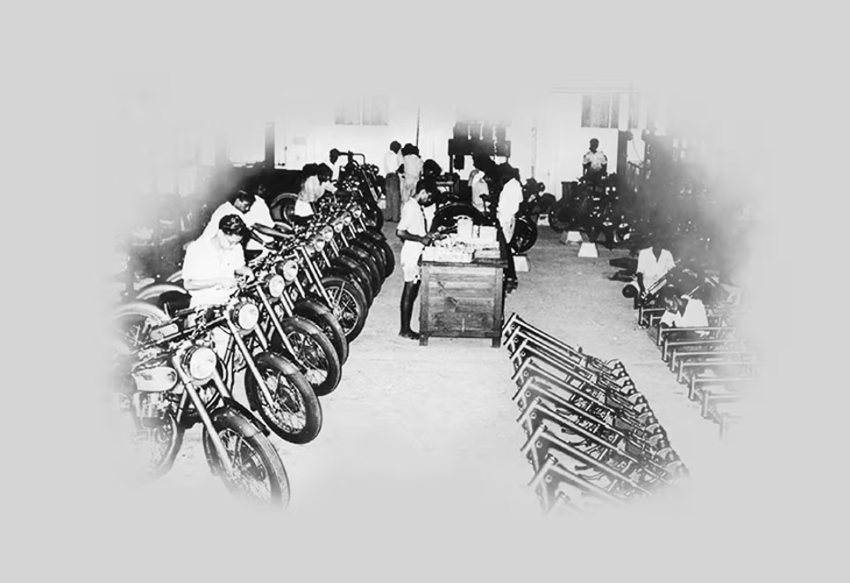
Launch of Royal Enfield in India
Arrived from Redditch in early 1953 Partnered with madras motors in India to form “Enfield India “ in 1955 Madras motors received an order from the Indian army for 500 350cc Bullets By 1962, all components were manufactured in India

Slide 5
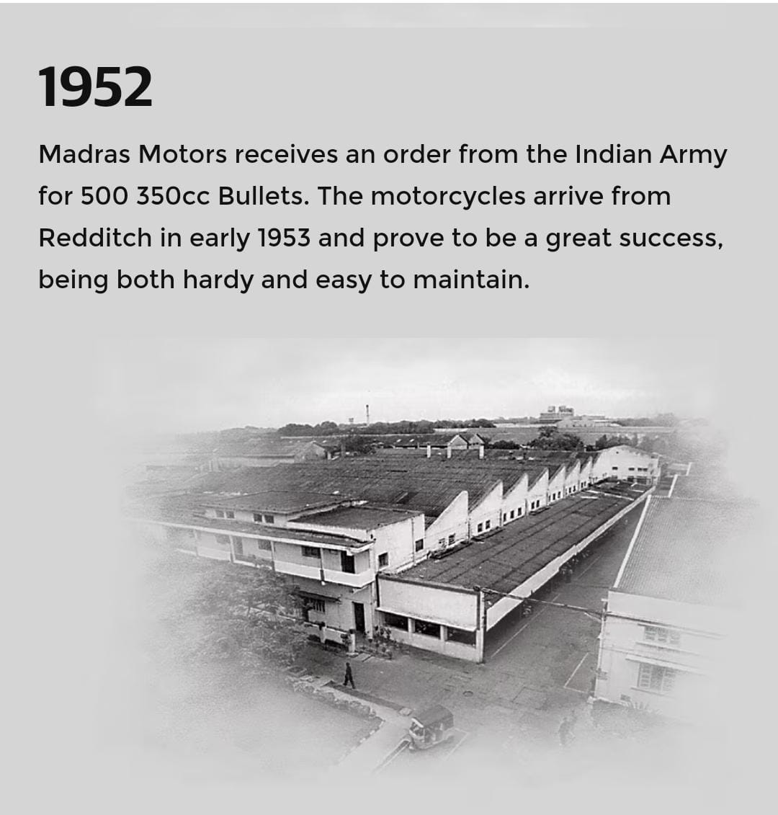
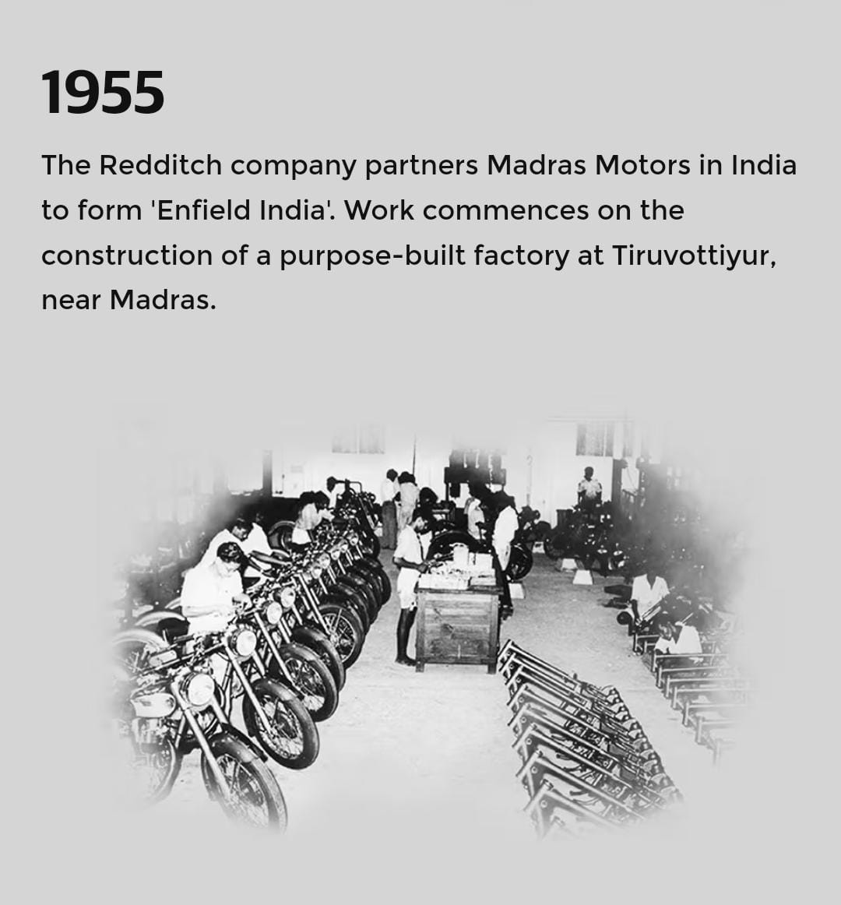
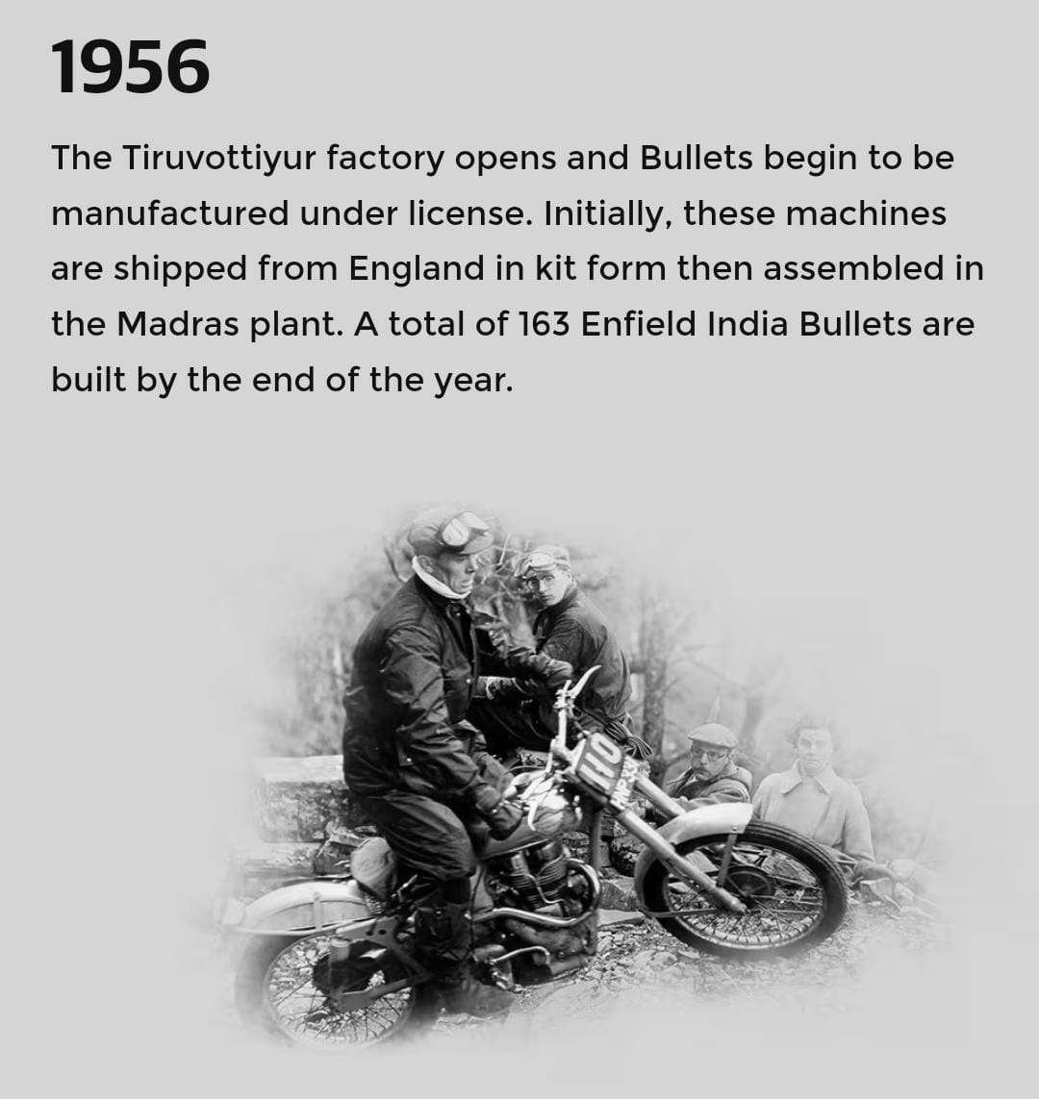
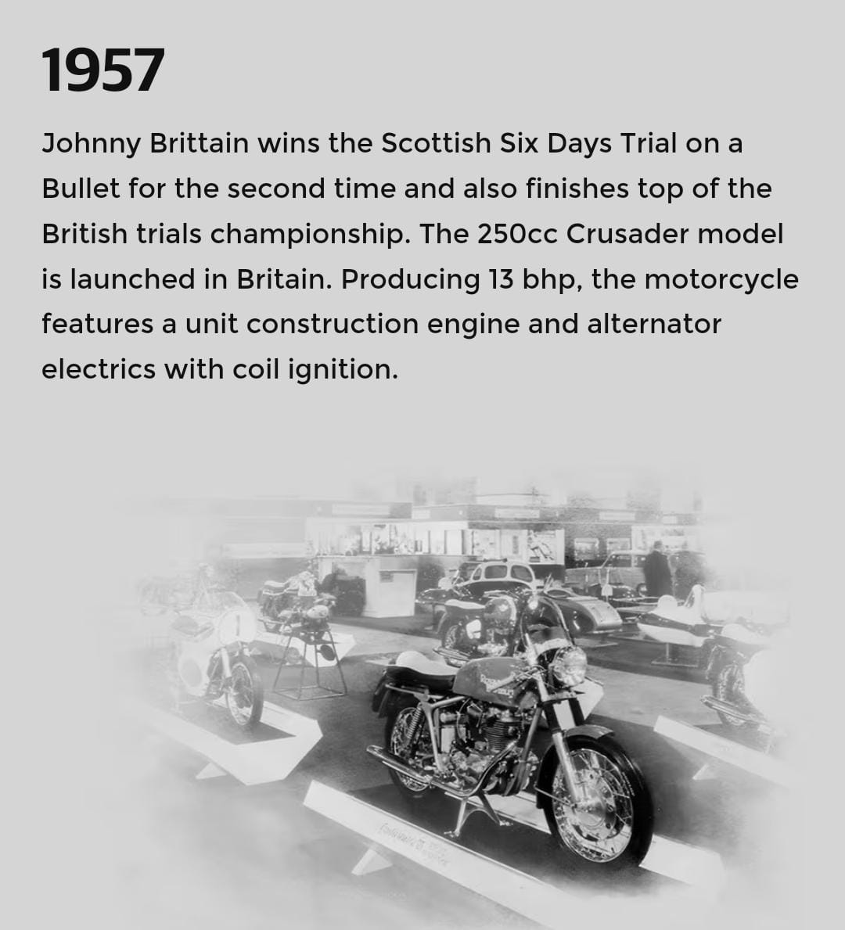
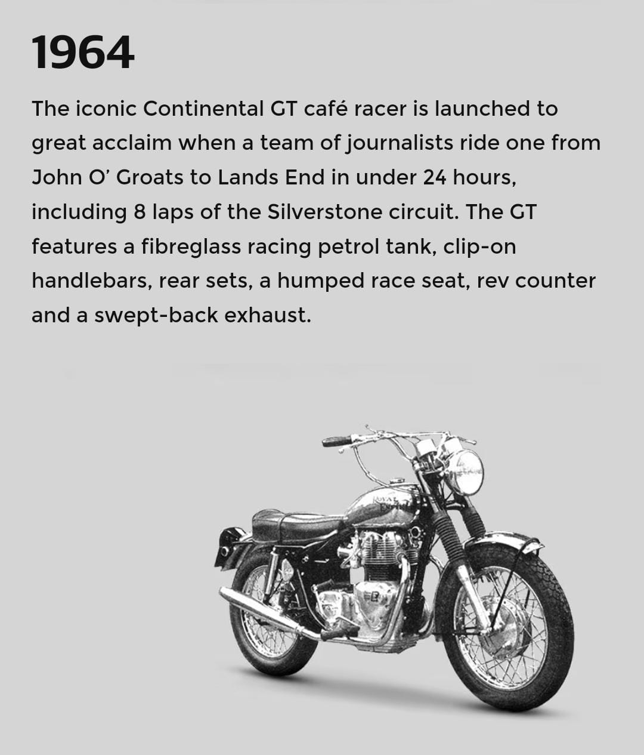
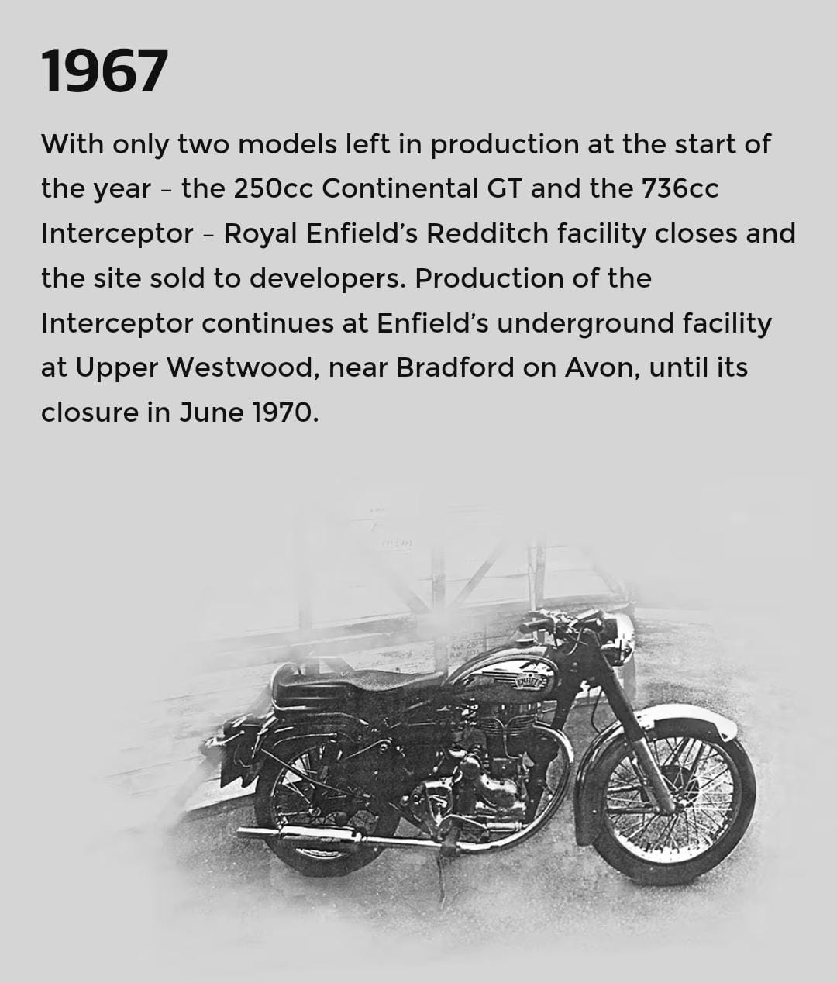
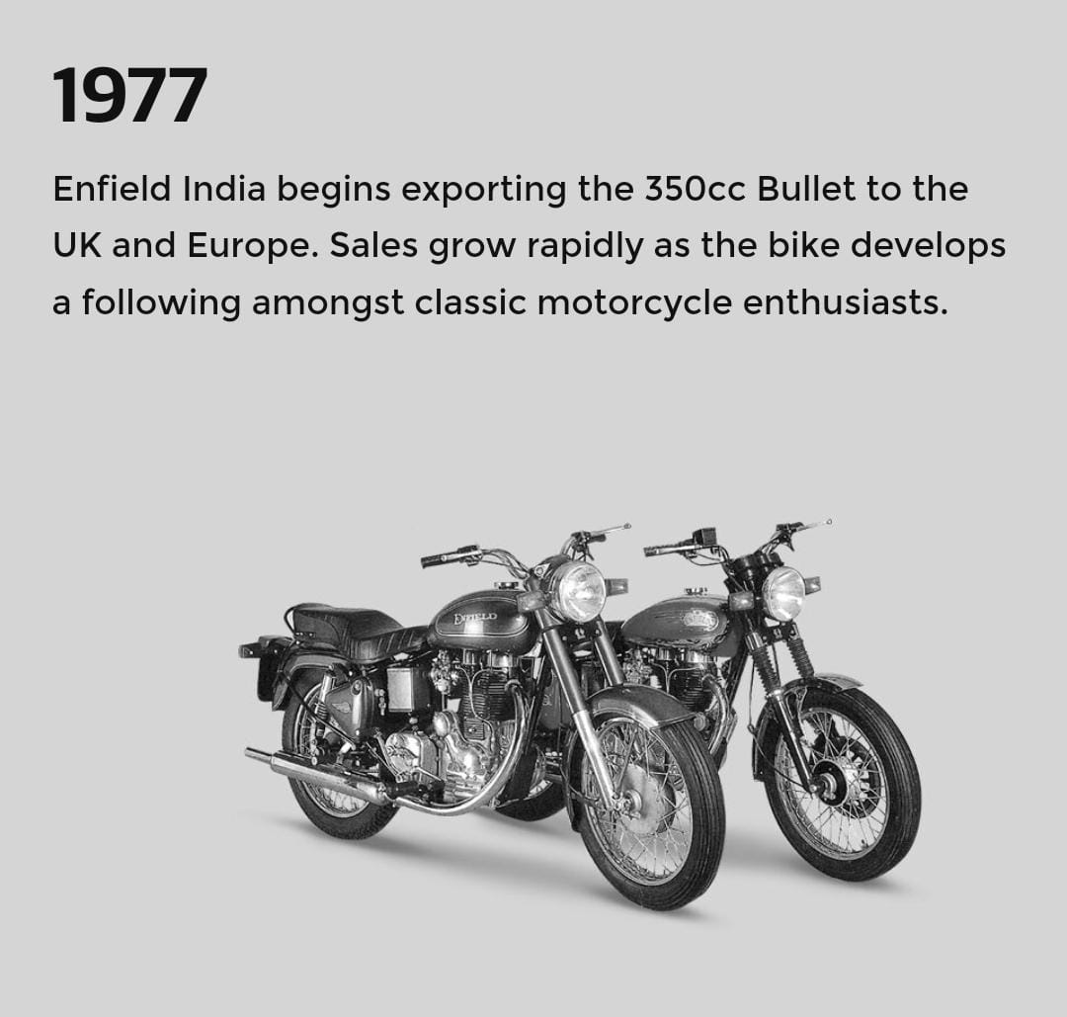
Brand Journey Timeline
1952
1955
1956
1957
1964
1967
1977
Madras Motors receives an order from the Indian Army for 500 350cc Bullets
The Tiruvottiyur factory opens and Bullets begin to be manufactured under license
Johnny Brittain wins the Scottish Six Days Trial on a Bullet for the second time and also finishes top of the British trials championship
The iconic Continental GT café racer is launched
With only two models left in production at the start of the year
Enfield India begins exporting the 350cc Bullet to the UK and Europe
The Redditch company partners Madras Motors in India to form 'Enfield India
1952
1955
1956
1957
1964
1967
1977

Slide 6
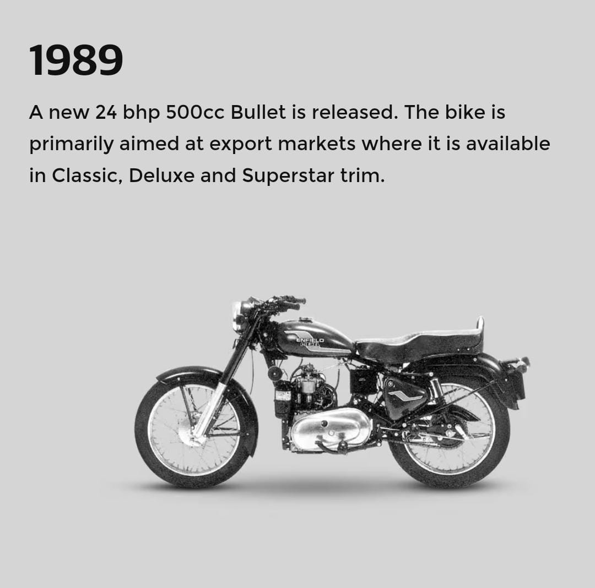
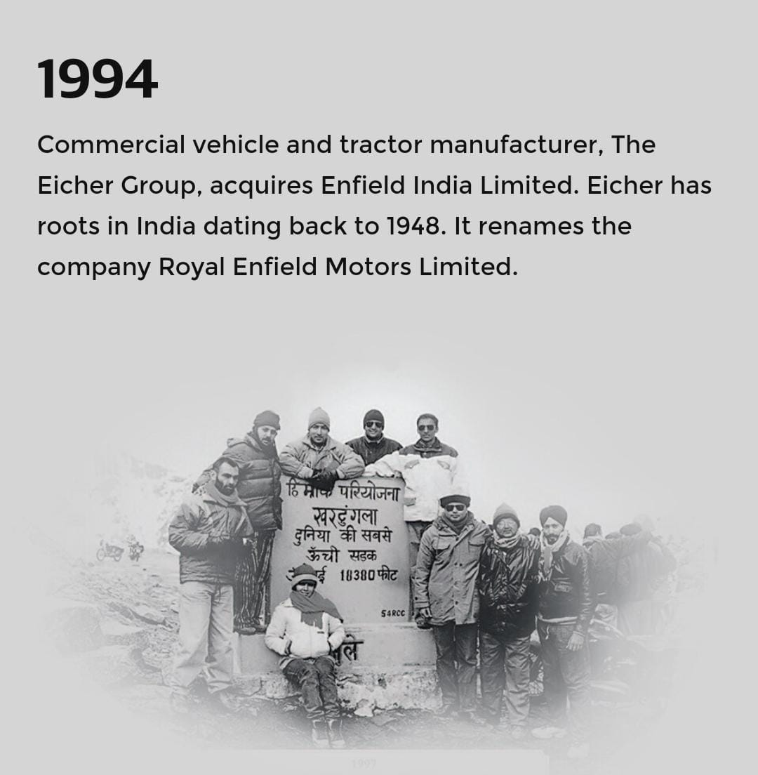
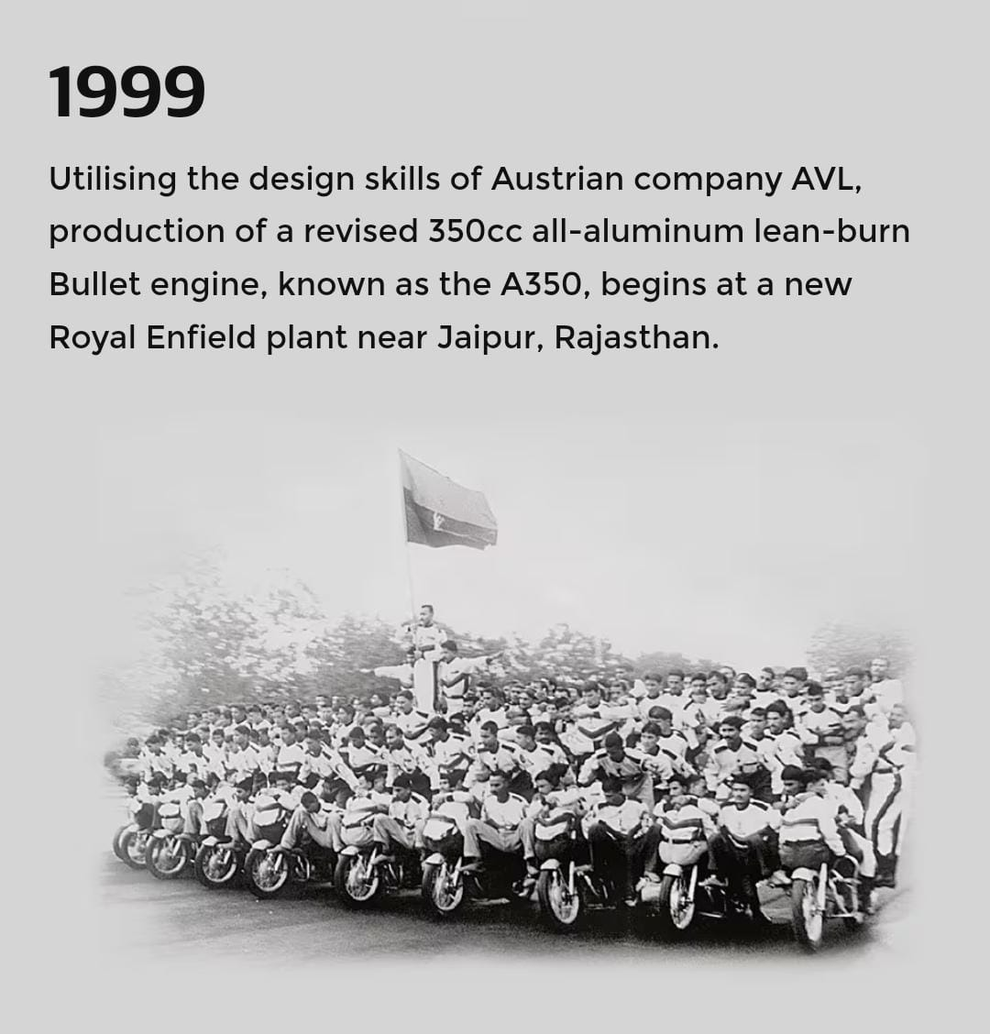
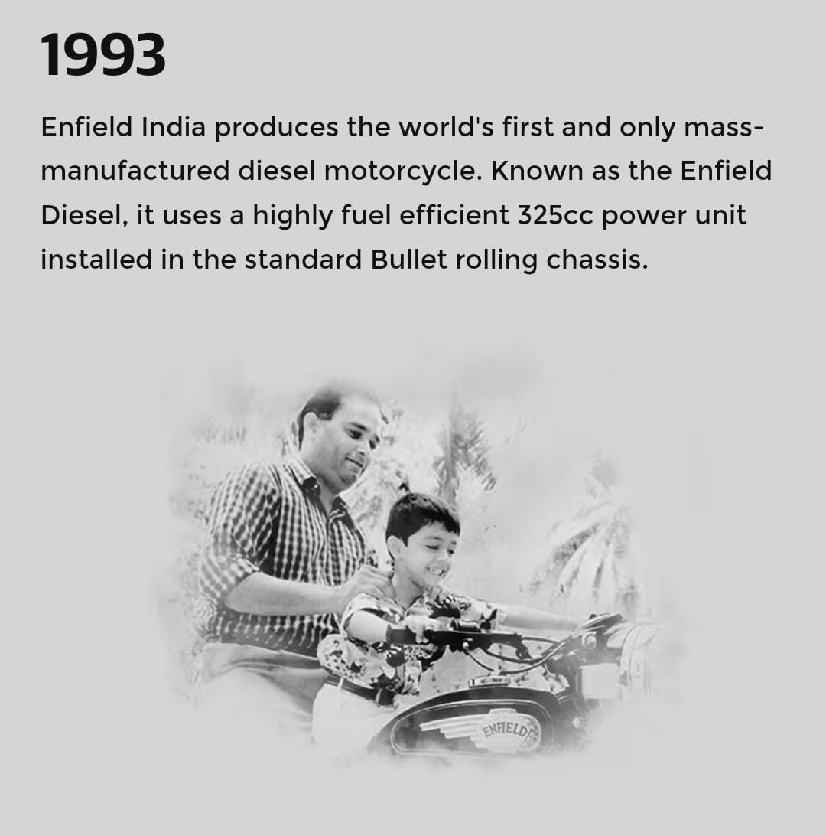
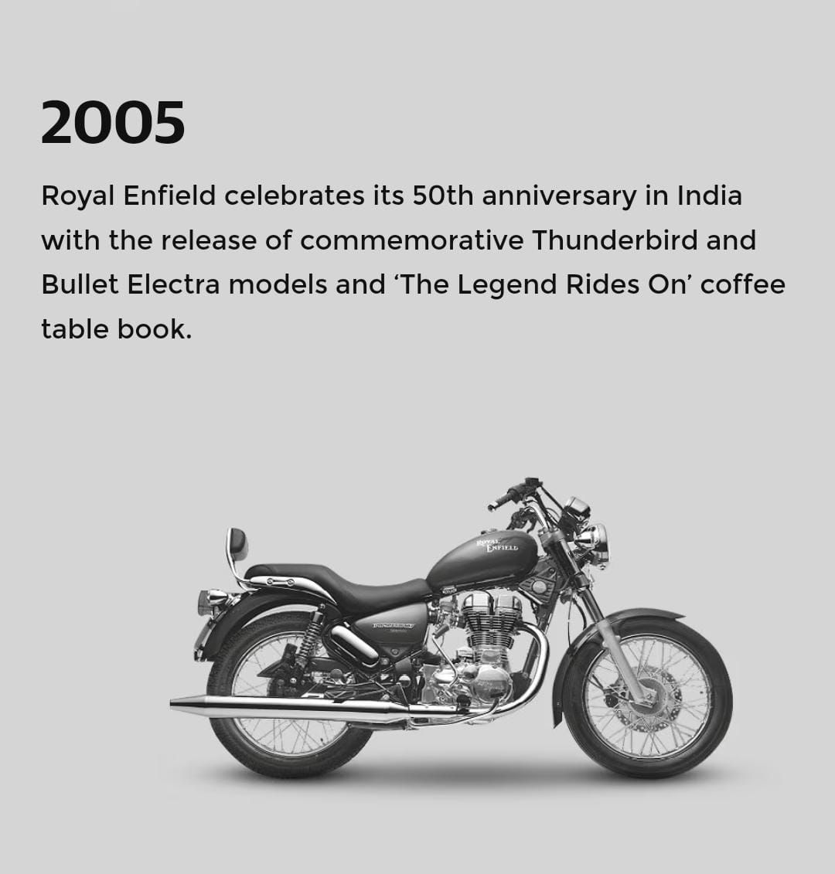
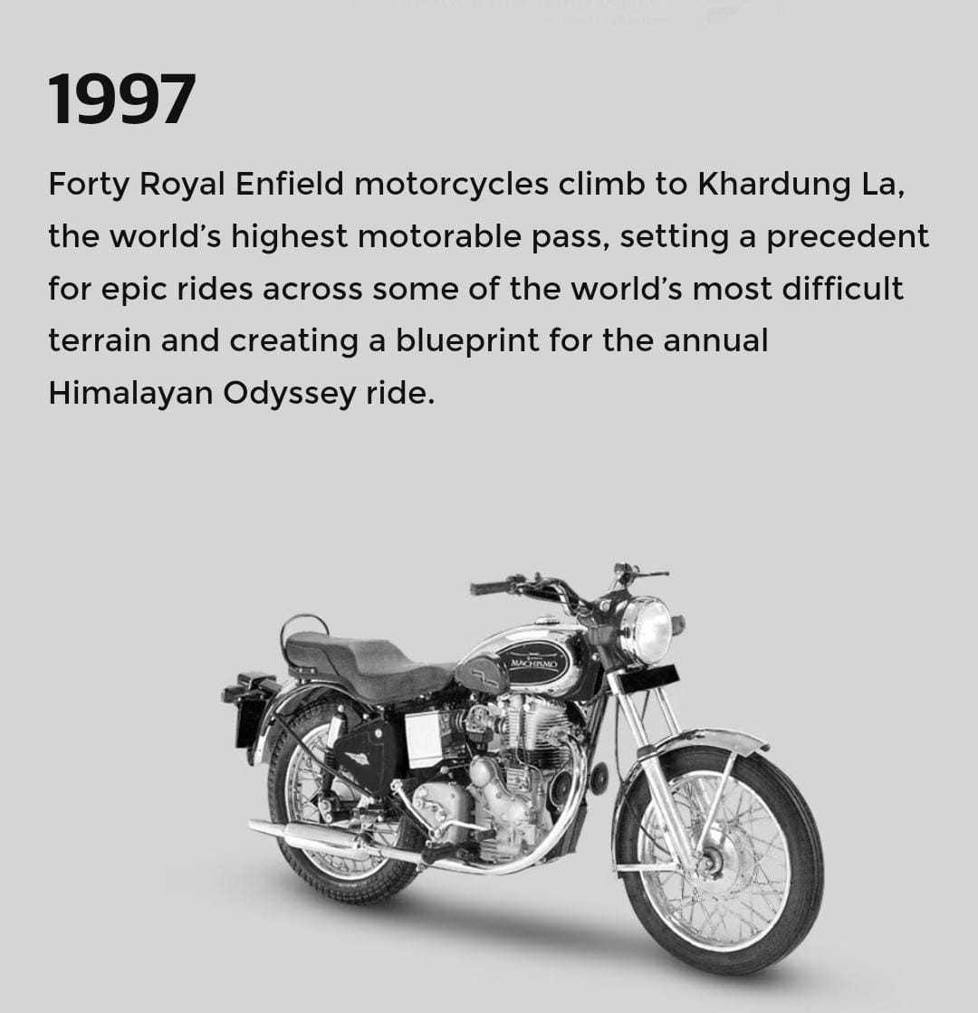
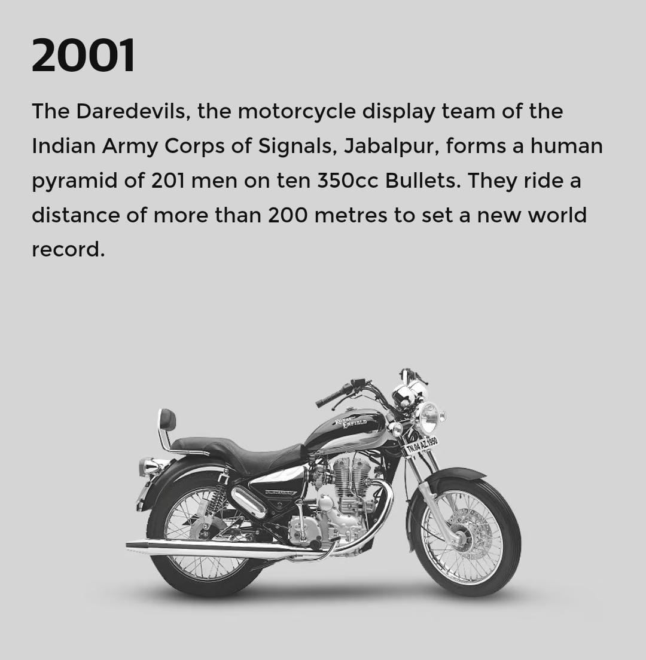
Brand Journey Timeline
1989
1993
1994
1997
1999
2001
2005
A new 24 bhp 500cc Bullet is released
Enfield India produces the world's first and only mass-manufactured diesel motorcycle
Commercial vehicle and tractor manufacturer, The Eicher Group, acquires Enfield India Limited
Forty Royal Enfield motorcycles climb to Khardung La, the world’s highest motorable pas
New Royal Enfield plant near Jaipur, Rajasthan
The Daredevils, the motorcycle display team of the Indian Army Corps of Signals, Jabalpur, forms a human pyramid of 201 men on ten 350cc Bullets
Royal Enfield celebrates its 50th anniversary in India with the release of commemorative Thunderbird in 2005
1989
1994
1999
2005
1993
1997
2001

Slide 7
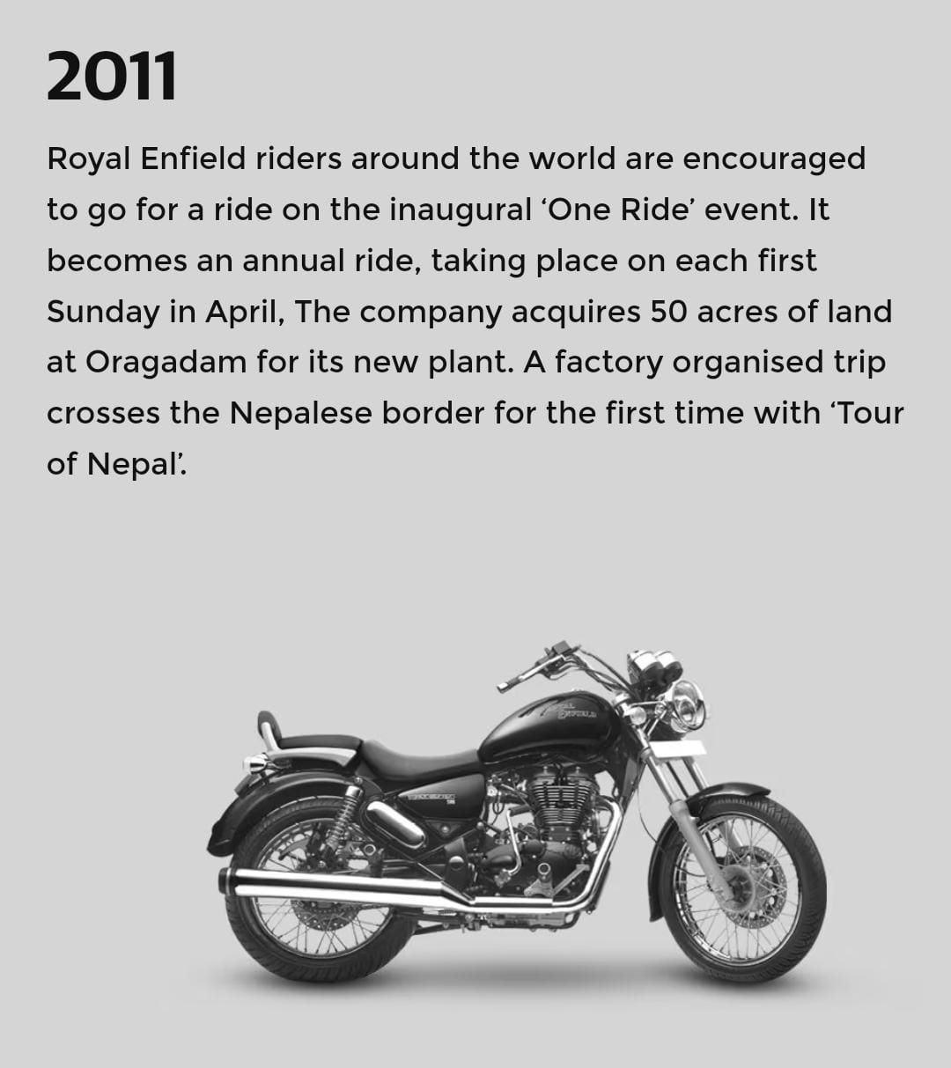
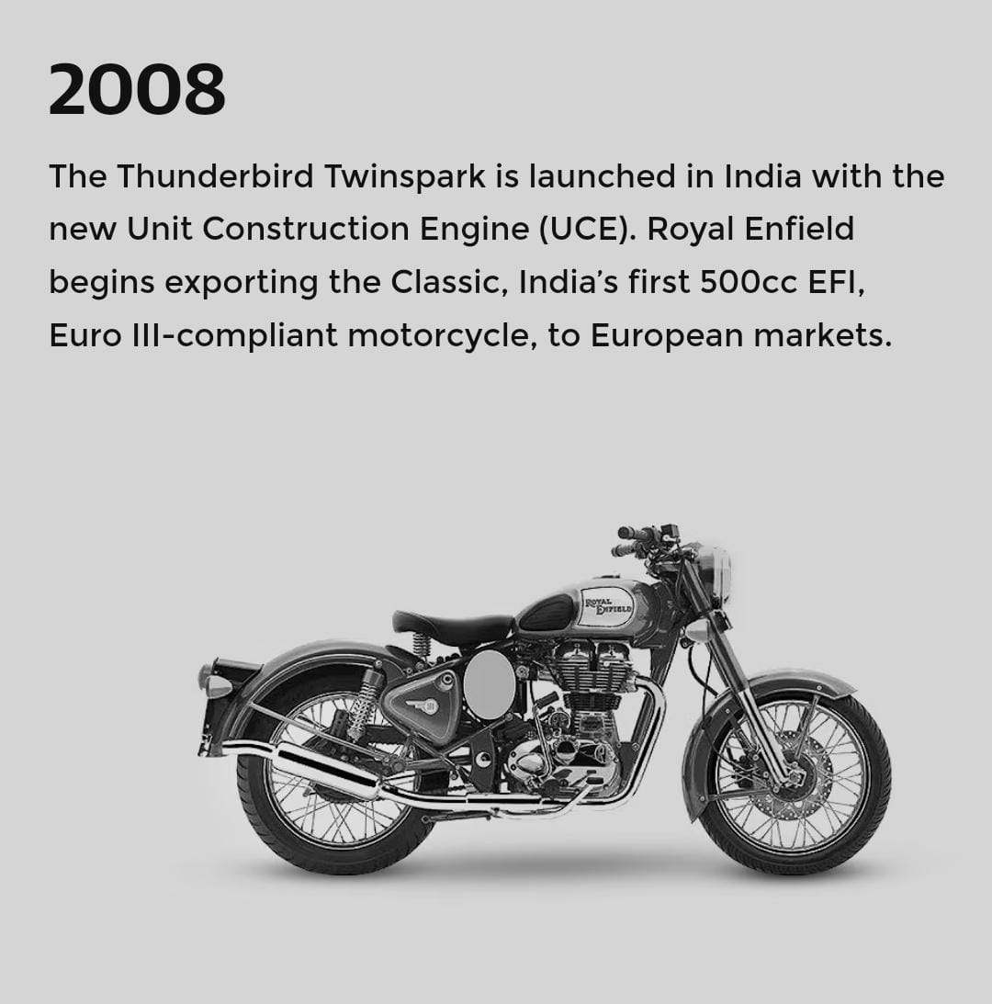
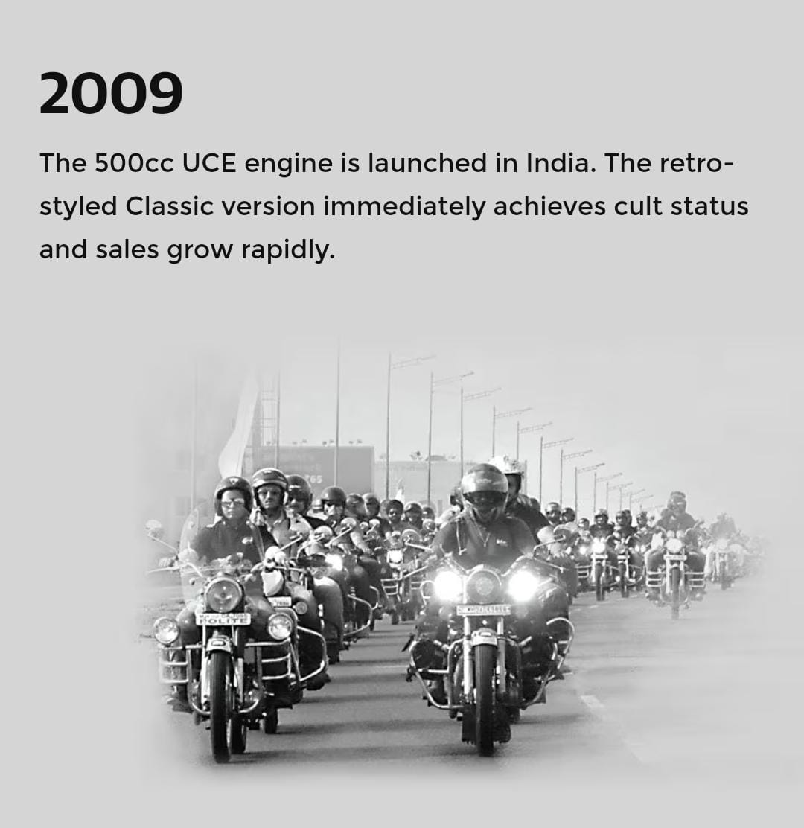
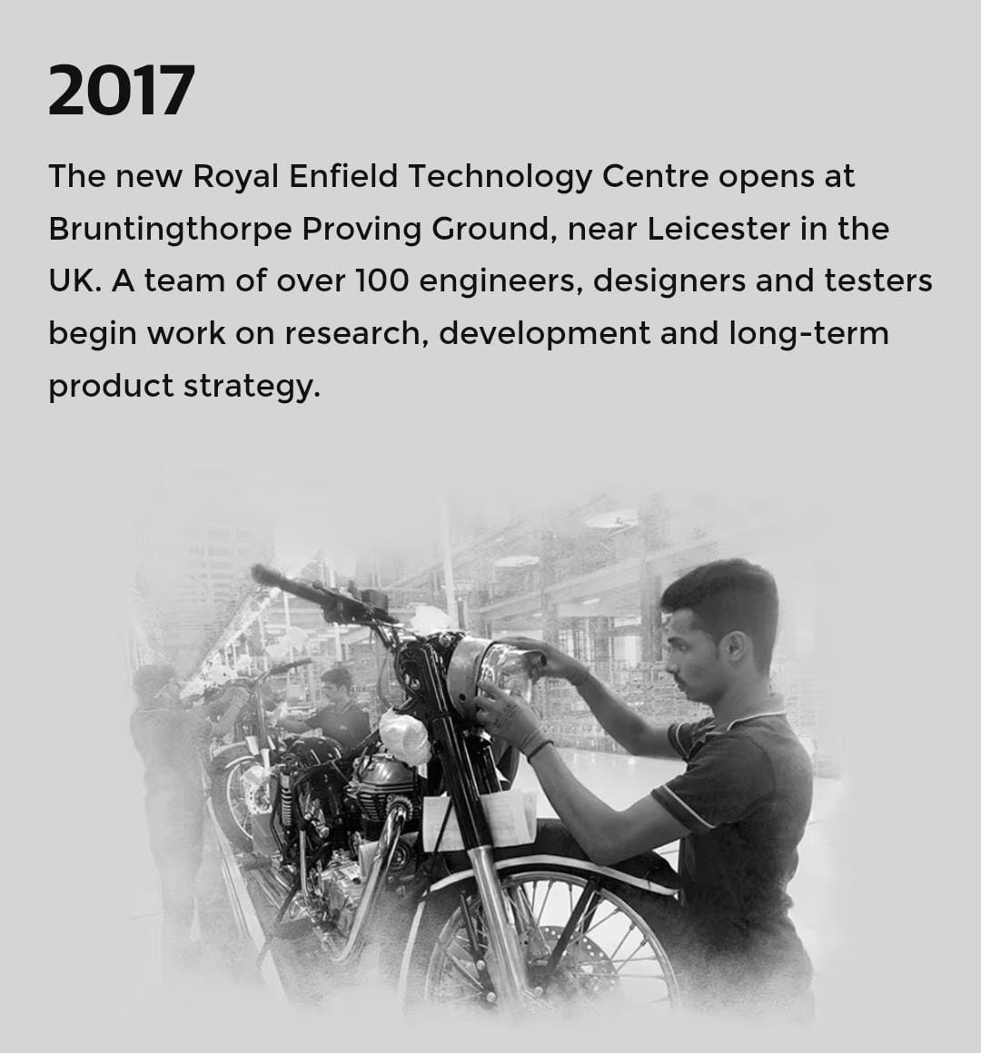
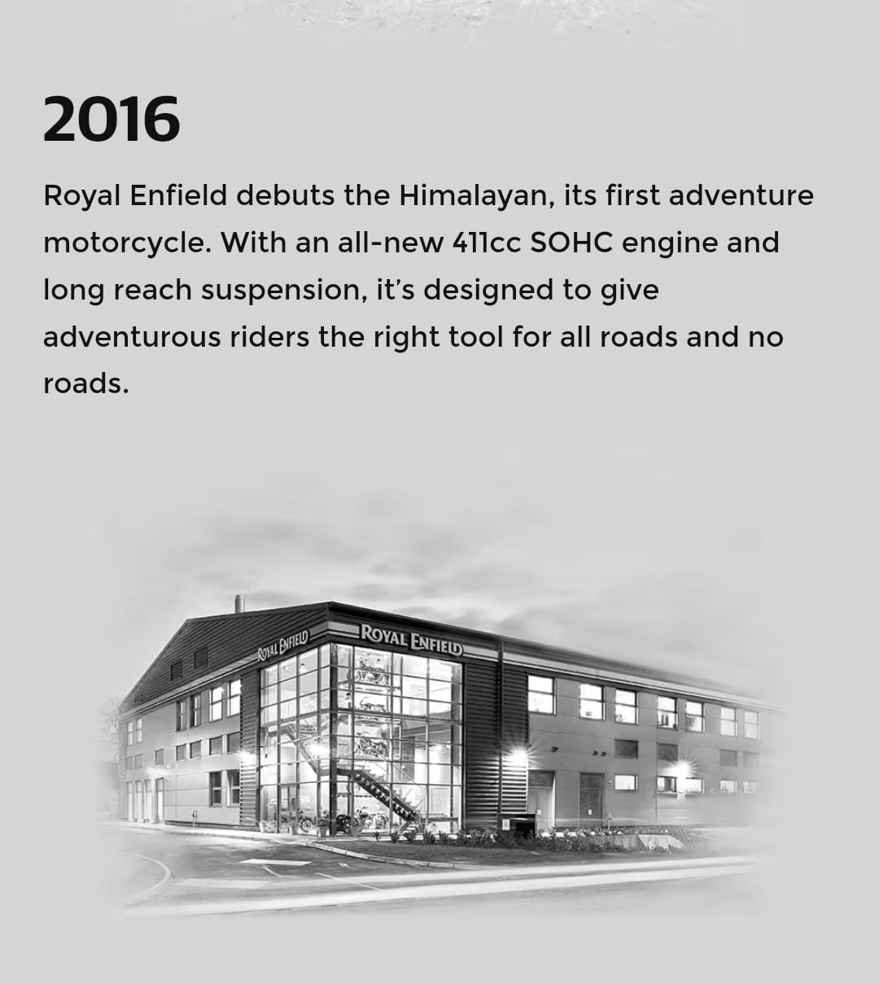
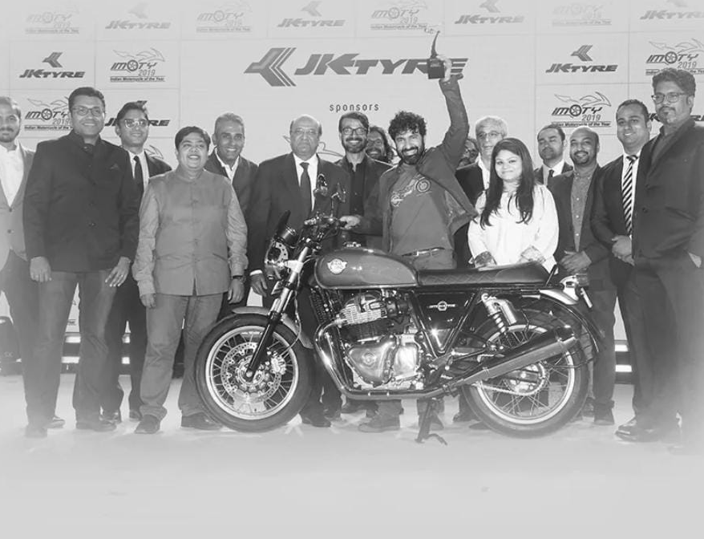
Brand Journey Timeline
2008
2009
2011
2017
2018
2019
The Thunderbird Twinspark is launched in India with the new Unit Construction Engine (UCE)
The retro-styled Classic version immediately achieves cult status and sales grow rapidly
Royal Enfield riders around the world are encouraged to go for a ride on the inaugural ‘One Ride’ event
The new Royal Enfield Technology Centre opens at Bruntingthorpe Proving Ground, near Leicester in the UK
Production commences at the company’s third plant. Located at Vallam Vadagal, near Chennai
A team of eleven Indian Army and Royal Enfield riders summit the 5,540m Karakoram Pass on Himalayans despite treacherous snow, ice and temperatures below -30°
2018
2008
2011
2009
2017
2019

Slide 8
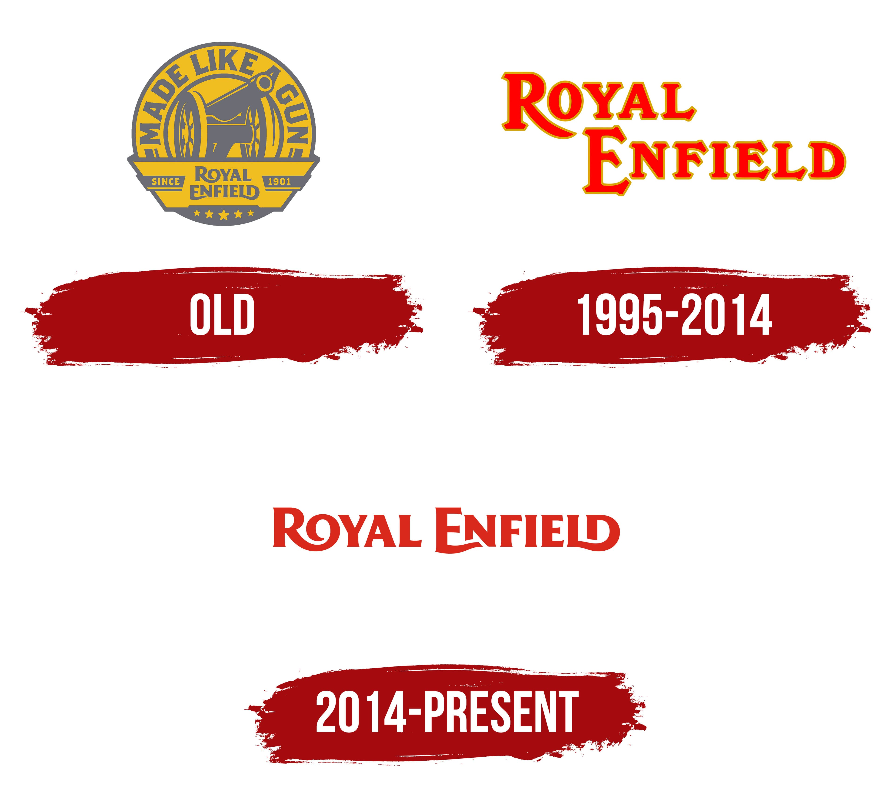
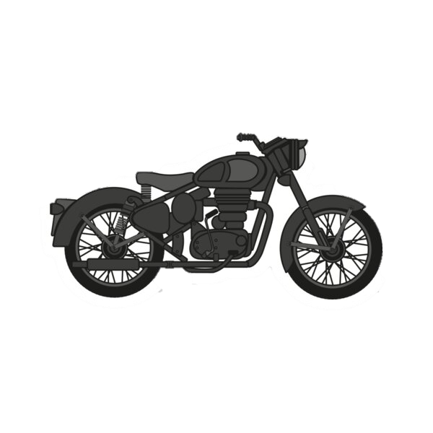
THE EVOLUTION OF ROYAL ENFIELD LOGO DESIGN THROUGH THE YEARS
1995-2014
1901
2014 –PRESENT

Slide 9
A MAJOR SETBACK FACED BY ROYAL ENFIELD
• In the year 2000, the board of directors of Eicher Motors decided to either shut down or sell off Royal Enfield division.
• The decline in sales, unable to face competition, not attracting the user base and the weak business strategies.
STEPS AND STRATEGIES USED TO MAKE A COMEBACK
They formed a field quality rapid action force to bridge the gap between customer expectations and reality.
•They consulted with international experts and carried out sound mapping or several hours to track the maximum number of rhythmic vibrations.
• Royal Enfield launched 500CC classic model and it was a huge hit in 2008.
• In November 2009, 350CC bike was launched in India, priced at Rs 1.20 Lakh.

Slide 10

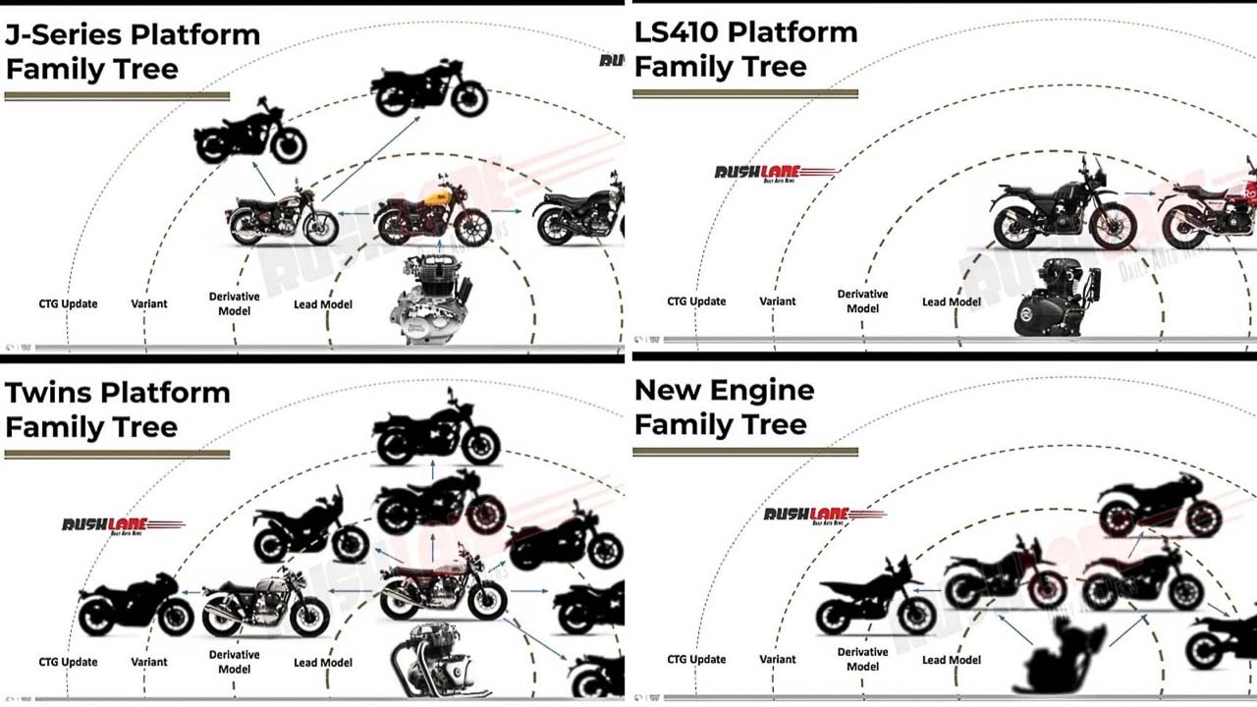
ROYAL ENFIELD TODAY
Royal Enfield celebrates 120 + years of Pure Motorcycling.
And many more upcoming exciting lineups
Production output - 2,25,368 units
Revenue - ₹3,986.00crore
Net income - ₹918 crore
Subsidiaries
Royal Enfield North America
Royal Enfield UK
Royal Enfield Brazil
Royal Enfield Thailand

Slide 11
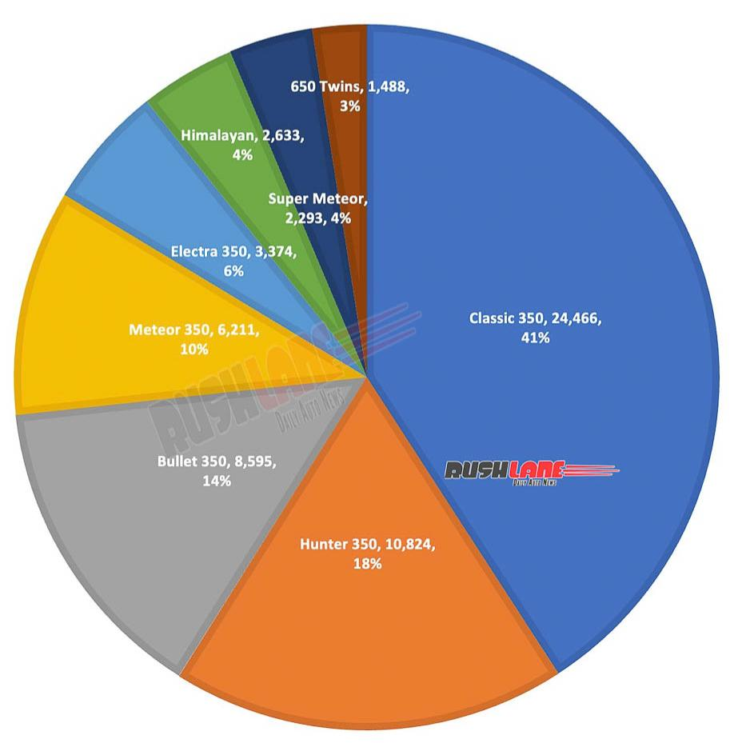
Royal Enfield sales 2023
Royal Enfield records total sales of 8,34,895 motorcycles, highest ever overall sales in history

Slide 12
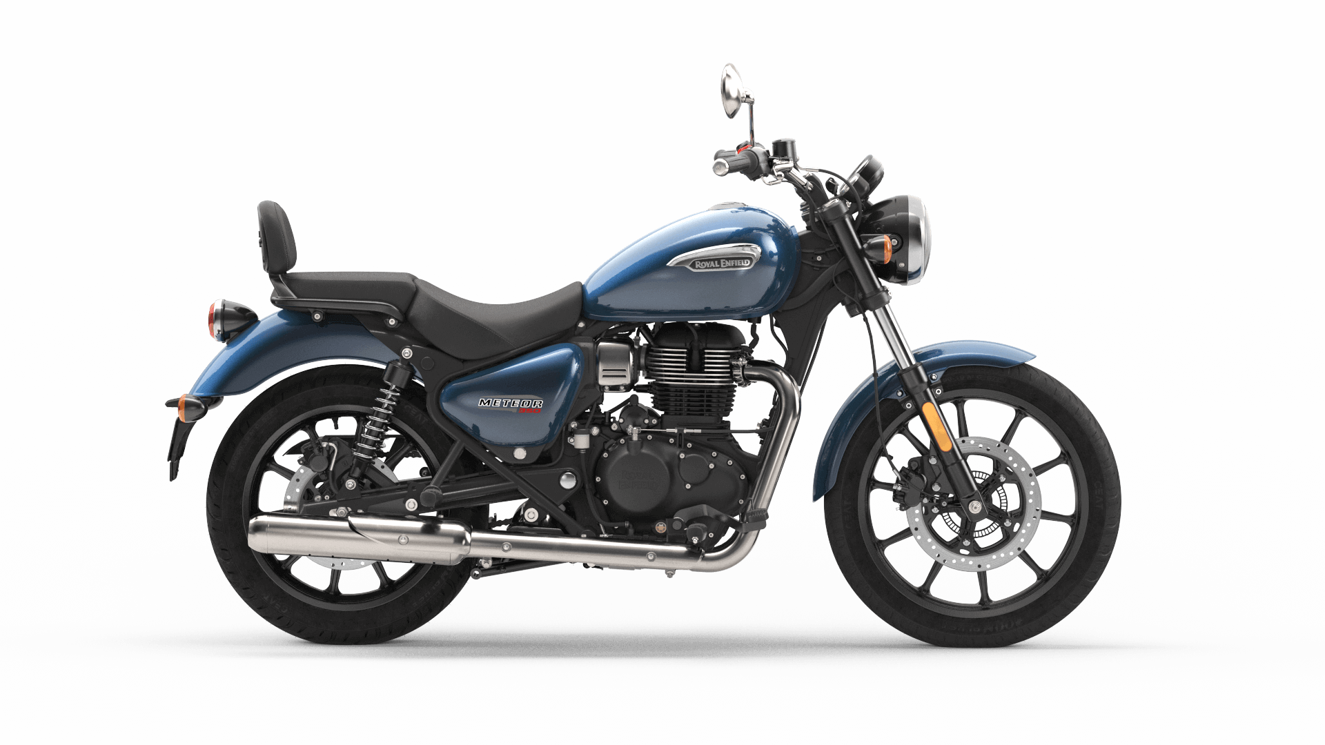
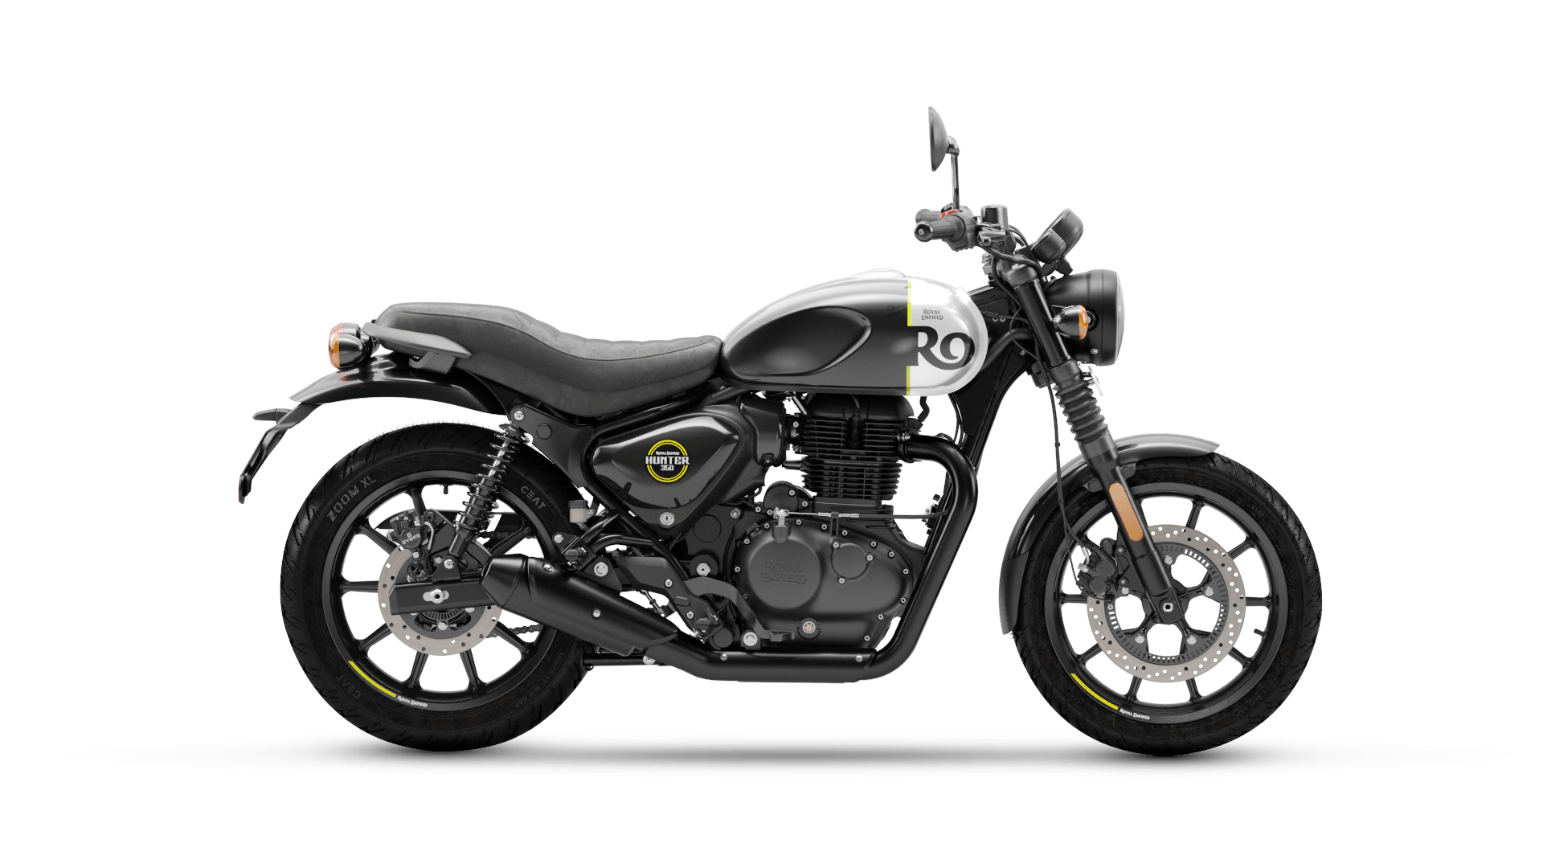
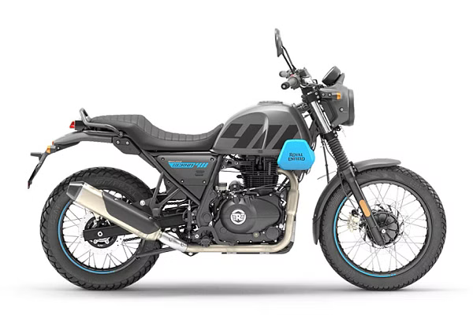
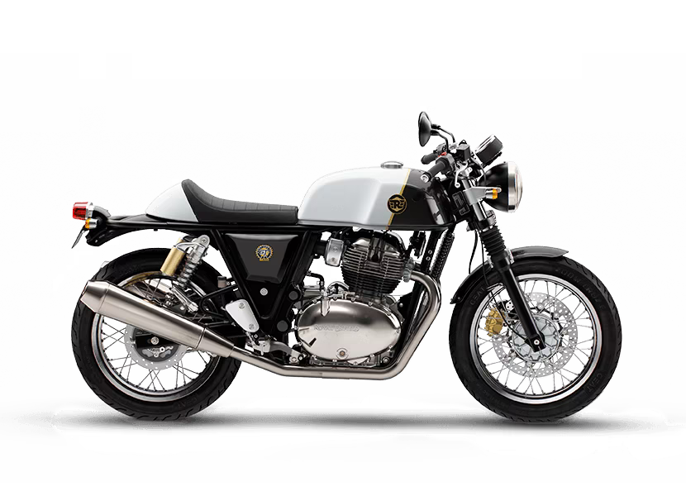
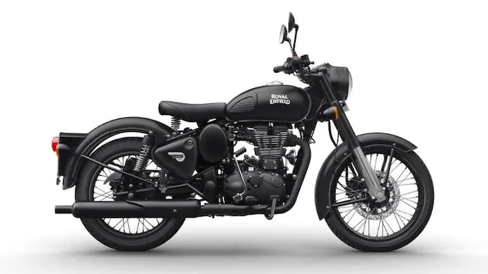
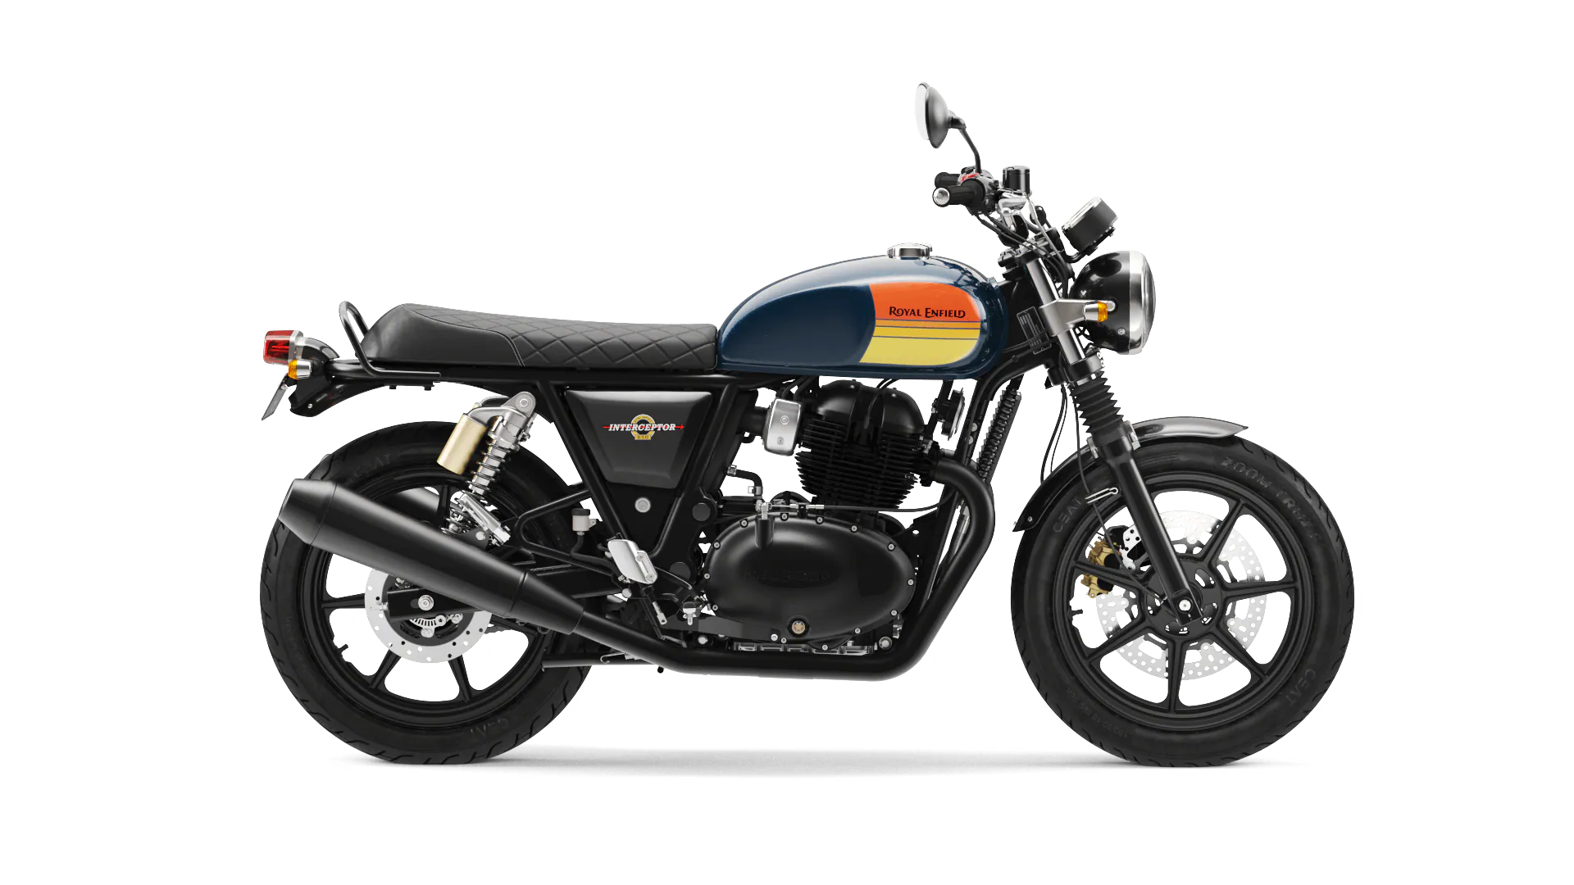
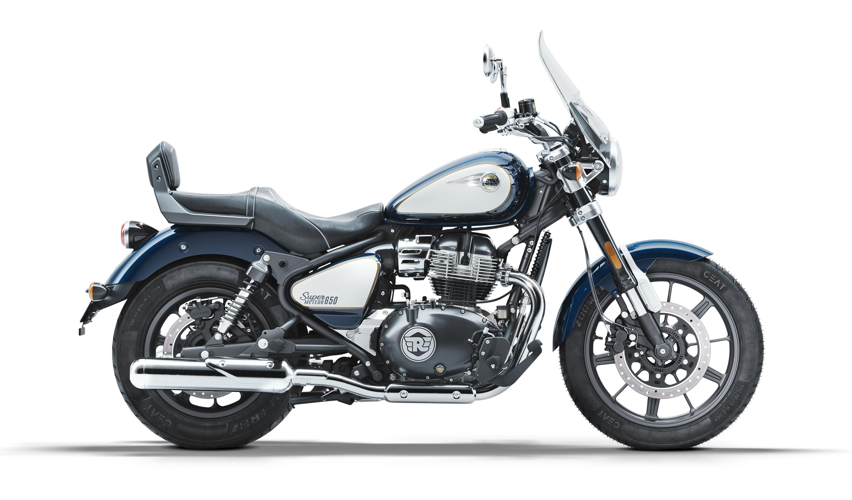
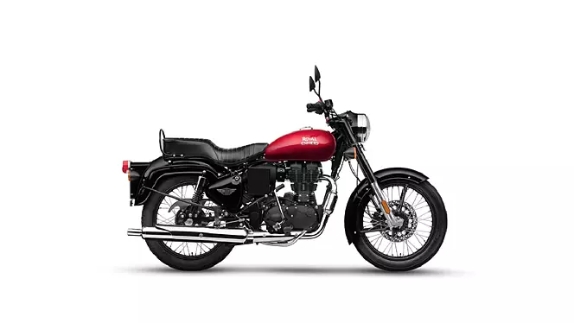
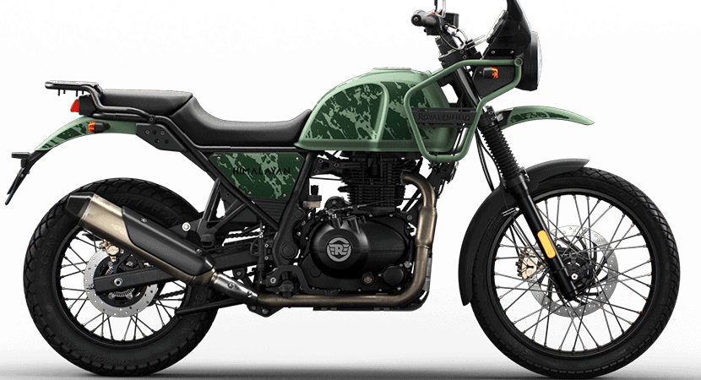
PRODUCTS PRESENT NOW AND AVAILABLE IN INDIA
METEOR 350
HUNTER 350
SCRAM 411
INTERCEPTOR 650
CONTINENTAL GT 650
CLASSIC 350
SUPER METEOR 650
BULLET 350
HIMALAYAN

Slide 13
CONCLUSION
The presentation objectively explains the rise of Royal Enfield from a brand on the brink of extinction to the most aspirational motorcycle brand in India.
It also highlights the segment under which the bike is positioned, describes its closest competitors and where RE holds value vis-à-vis Bajaj and KTM.
It shows the company's ambition to further go upmarket by entering the 750cc + segment to augment its declining market share in the 350cc+ segment.
Royal Enfield's strategic acquisition plan of Ducati will counter Bajaj's 'Triumph' acquisition and also set a platform to launch the brand into a global league.

Slide 14

THANK YOU

